Slide 1


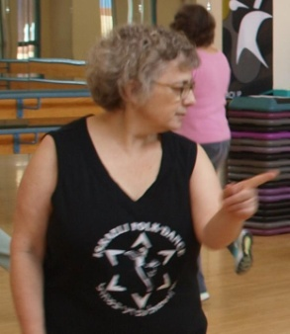

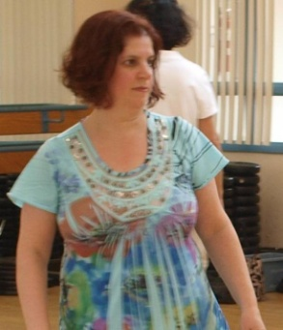
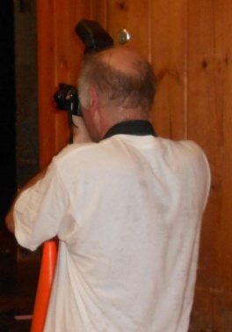
The Pittsburgh Powwow
Starring
John Forbes
Idan Raichel
Cherie Maharan
Yaron Ben Simchon
Lynn Berman
Marc Rauer, from Behind
There are 11 slides in this presentation. Progress through the slides by mouse clicking! The last slide contains two Youtube videos which you can start and stop.
Notes:
Cherie.jpg, lynn.jpg, marc rauer.jpg, john forbes.jpg, yaron ben simchon.jpg, idan Raichal.jpg

Slide 2
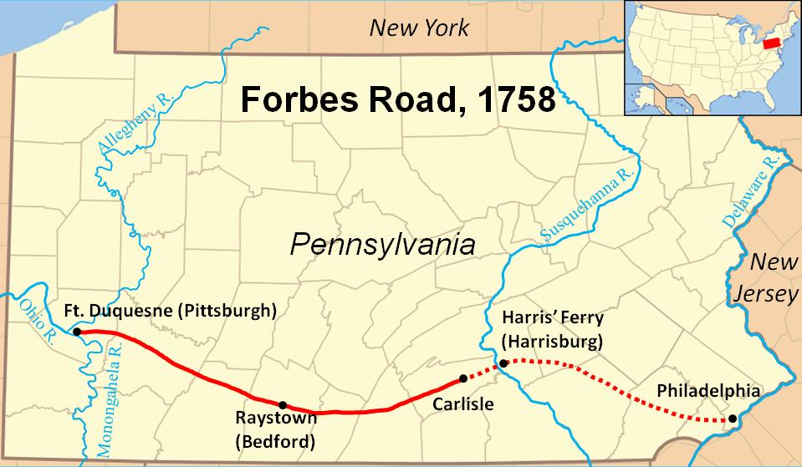
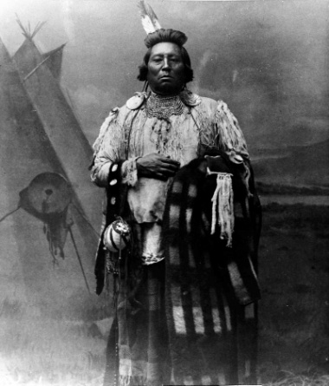
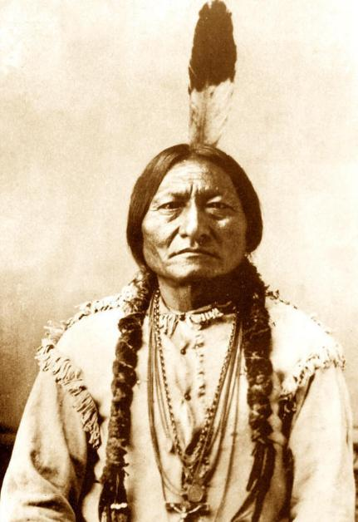
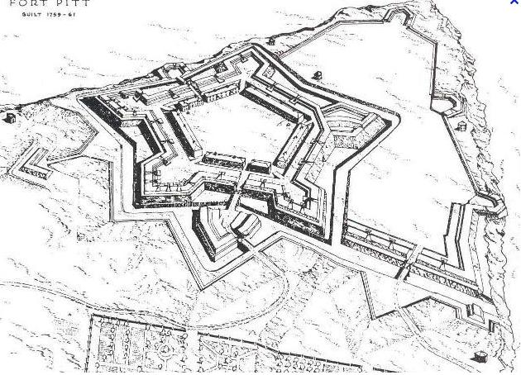

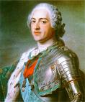
Below, left, is Gen John Forbes, the British General in charge of British American forces in the French and Indian War of the middle 1700’s.
He wanted to invest Fort Duquesne where Pittsburgh is today. To do so, he adopted a multi level strategy.
Build the Braddock road to move men and supplies to the front (Ft Duquesne)
Make treaties with the Indian tribes to keep the tribes from supporting the French
Surround (invest) Fort Duquesne as the French abandoned the fort
Created a new fort, Fort Pitt, which is the basis of present day Pittsburgh
An unintended consequence of the Braddock road was to cement Pennsylvania’s claim to this region (against other colonies, especially Virginia) defining the state’s borders
Notes:
john forbes.jpg, ft pitt.jpg, indian1.jpg, indian2.jpg, louisxv.jpg, louis.another.jpg, braddock road.jpg

Slide 3
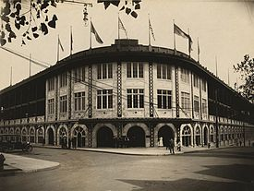

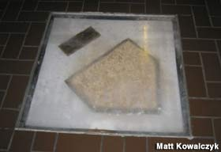
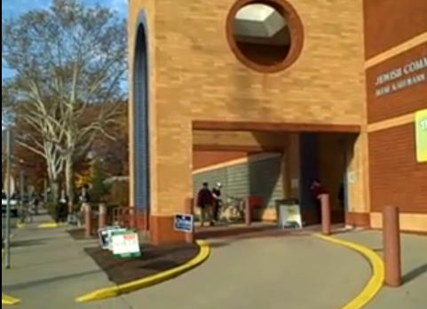
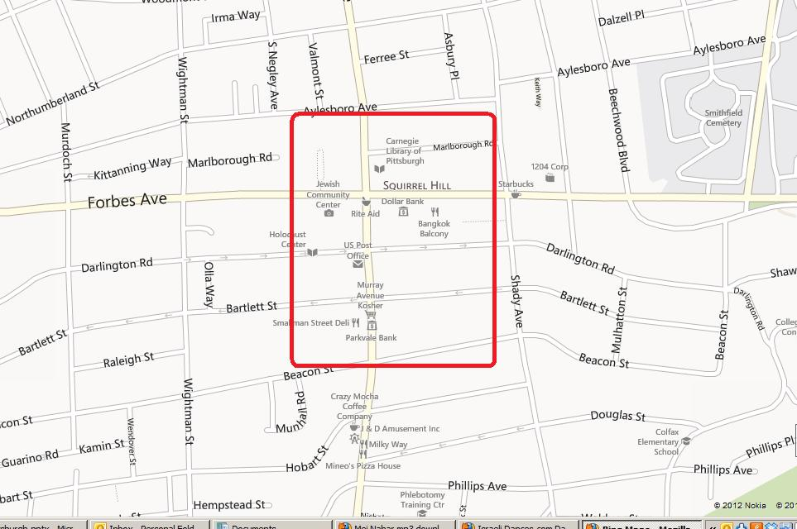
Pittsburgh Today
Pittsburgh today is a vibrant modern city. Below are some pictures taken from the internet and also taken by your instructor while in the city. To the left is old Forbes field, where the Pirates played for much of the last Century and next to that is the home plate of that stadium encased in the library of the University Of Pittsburgh.
The last picture on the first row is of Pamela’s, one of the best delis in the city and where several dancers ate on the morning of the marathon.The last picture (first picture second row) shows the facility where the powwow took place.
An area map of squirrel hill is provided at the end
Notes:
pittf.jpg, pittg.jpg, pitth.jpg, pitti.jpg

Slide 4
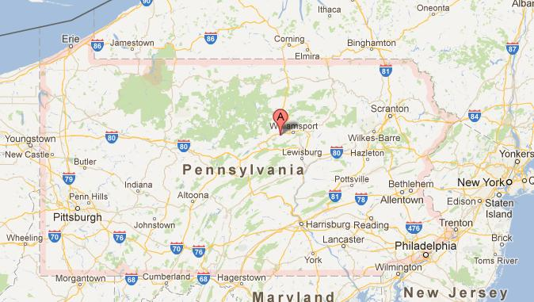
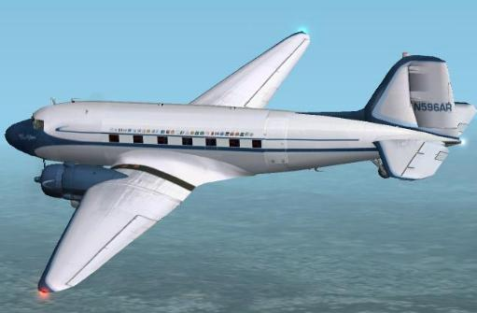
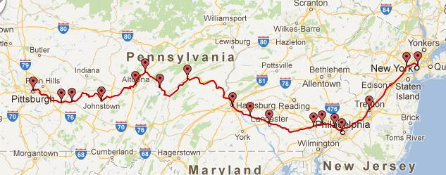
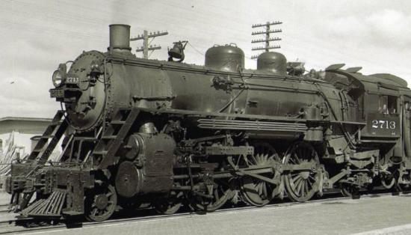
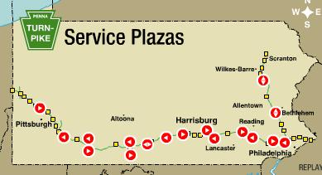

Getting to Pittsburgh
Your Instructor decided to go by car. The trip from Phila to Pittsburgh is best done by the Pennsylvania Turnpike.
The trip by car is 5 hours. By Air it is less than an hour of flight time but this does not include time spent at the airports.
Amtrak provides service from Phila to Pittsburgh but the trip is over 8 and a half hours.
Notes:
Pa map.jpg, turnpike.jpg, trainroute.jpg, steam.jpg, prius.jpg, dc3.jpg

Slide 5


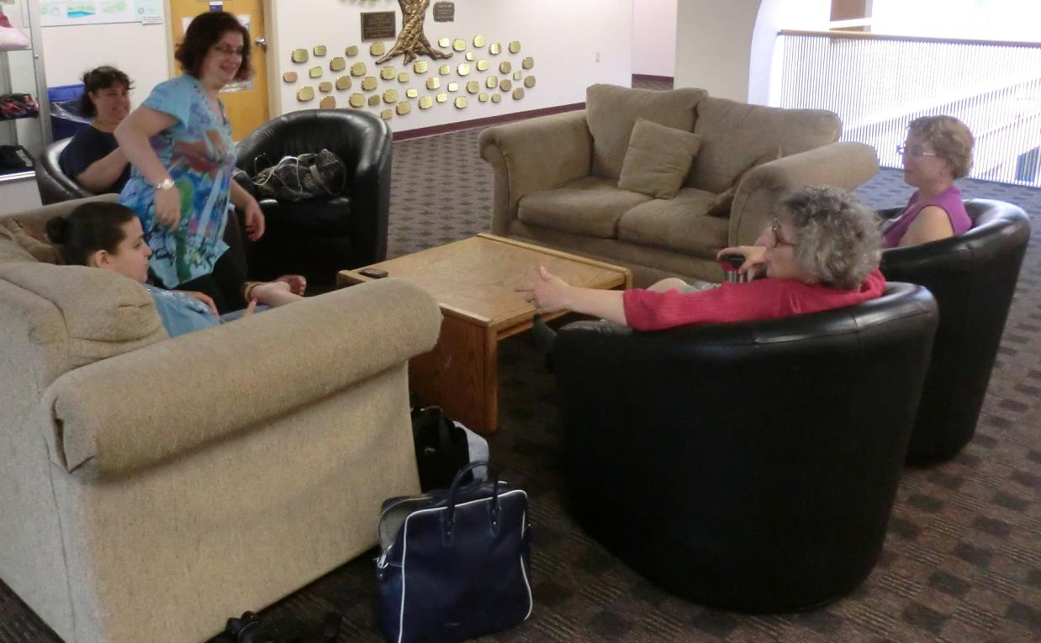
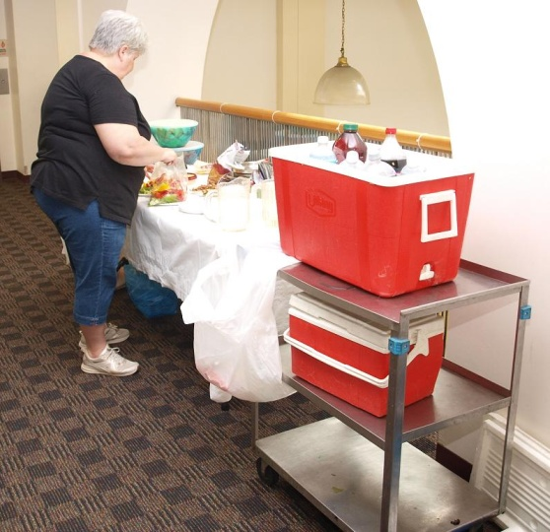
The Powwow gets started
The leaders of the Pittsburgh session, Lynn to the left and Cherie to the right, who played hosts, relax just before the powwow starts
While the food is being prepared to the right, Cherie and Lynn are joined by other dancers before the powwow starts
Notes:
pitt1.jpg, pitt2.jpg, pitt3.jpg, pitt4.jpg

Slide 6
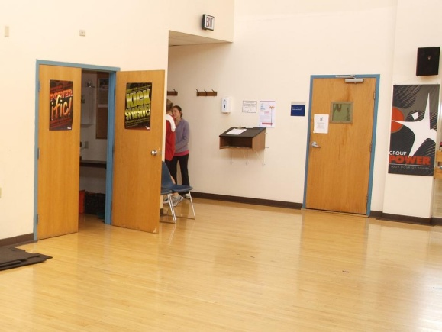
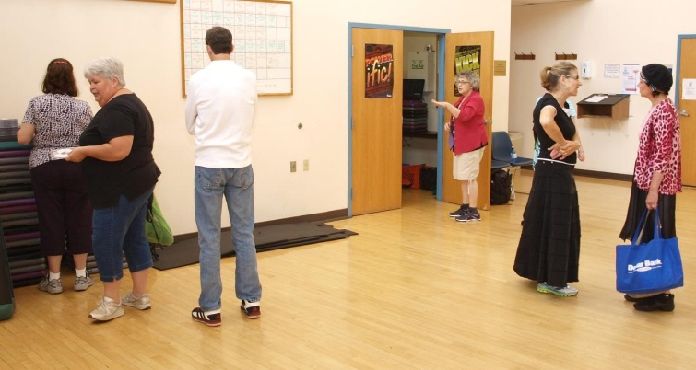
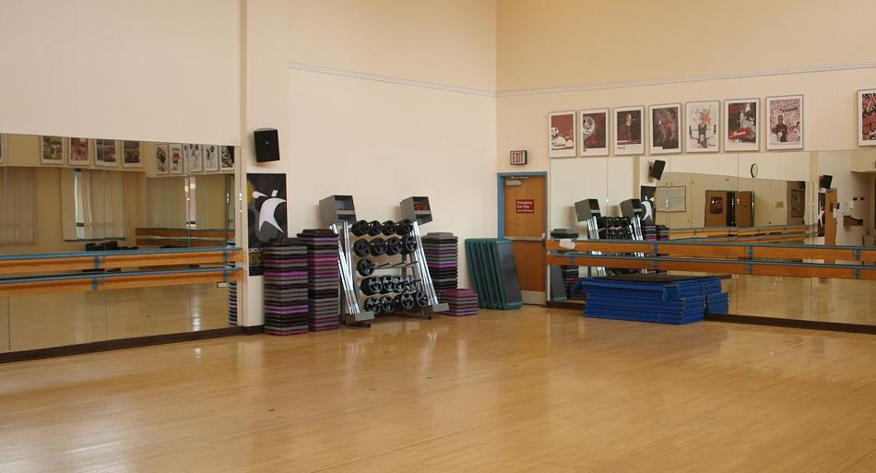
The dance studio starts to populate with dancers
We’re about ready to start. You can see from these pictures that this is a room that can handle both dance sessions (barre and mirrors) and more athletic activities (weights and mounts). The closet doubles as the audio center having a feed for Cherie’s computer.
But, before showing the pictures of the participant’s dancing, what is Israeli dancing
Israeli dancing – known originally as Palestinian dancing – was part of International folk dancing. Even today, an International folk dance session will feature about 15% of older Israeli dance
Sometime in the 1970’s, more modern choreographers started to choreograph ballroom dance steps to faster and more modern music.
The state of Israel, through its ministry of culture, requires choreographers to vet their steps and interpretation of music
Israeli dance is broken down into circle, line and partner options
Notes:
pitt5.jpg, pitt6.jpg, pitt7.jpg

Slide 7
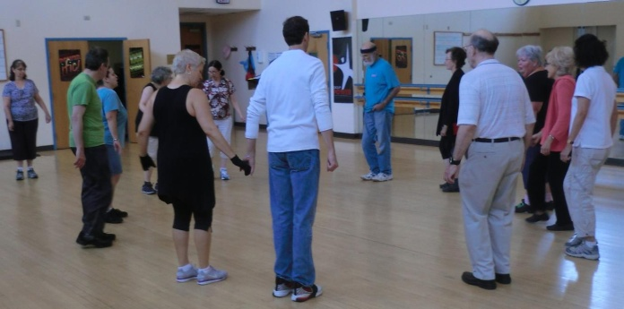
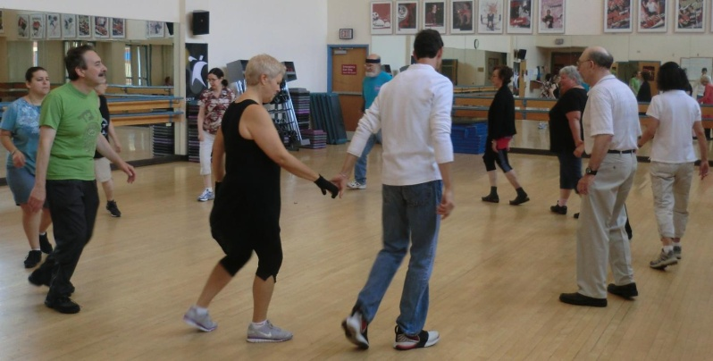
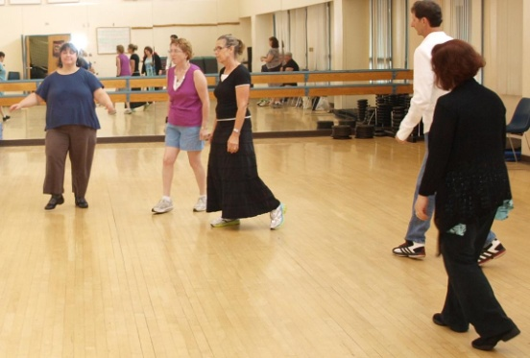
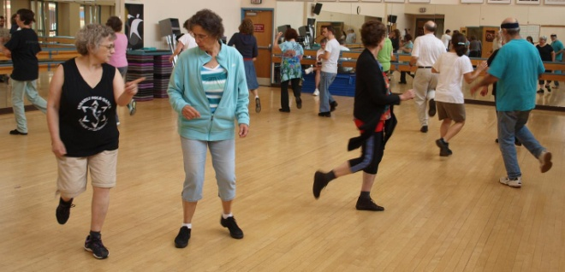
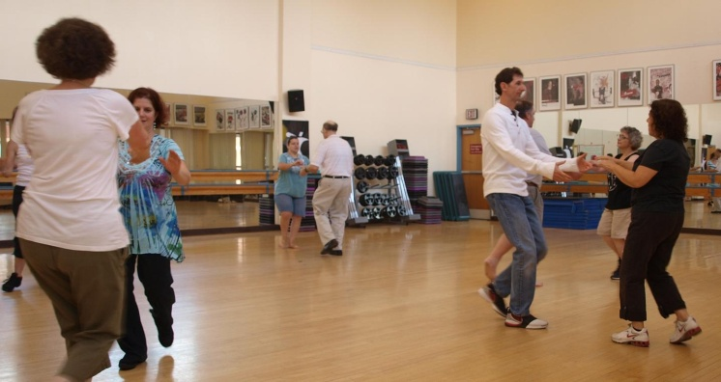
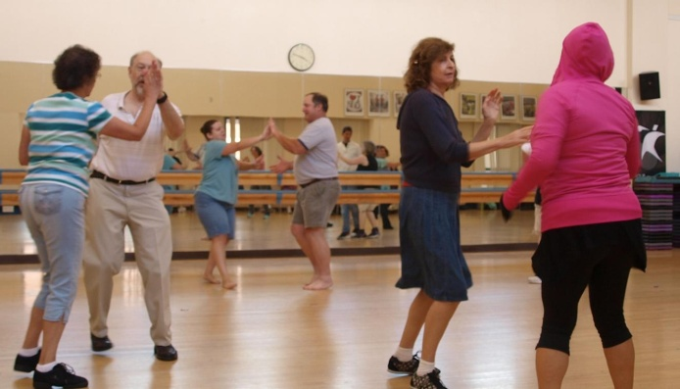
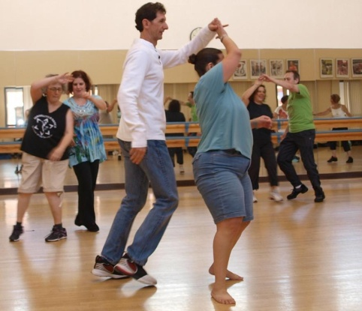
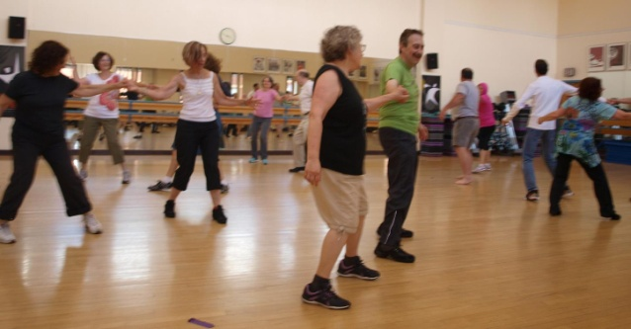
The pictures above show some early circle dances. At this point we have some Pittsburgh dancers supplemented with several dancers from Cleveland. Every piece of music being played has specific choreographed steps
Below (and the right) are pictures taken later at the partner dancing. As opposed to ballroom dancing, every step in an Israeli dance is choreographed. Given this, the choreographers tend to create more ‘violent’ turns
Notes:
pitt9,pitt10,pitt11,pitt21, pitt25,pitt26,pitt27,pitt28

Slide 8
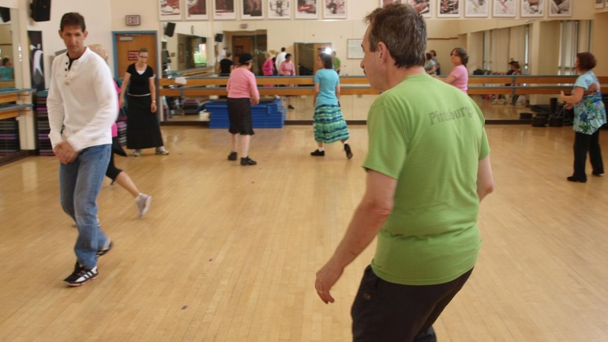
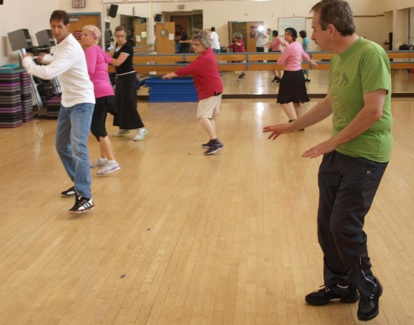
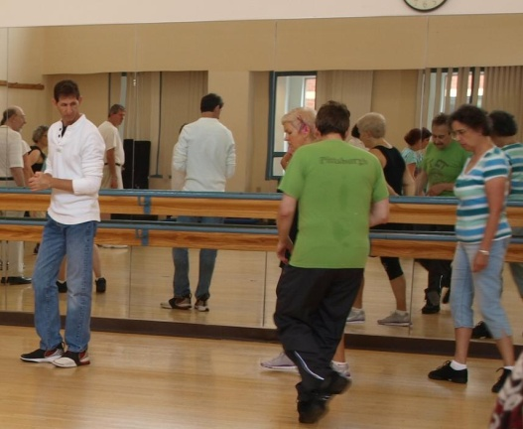
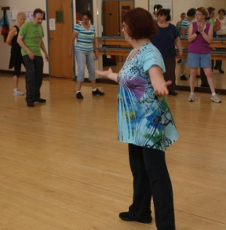
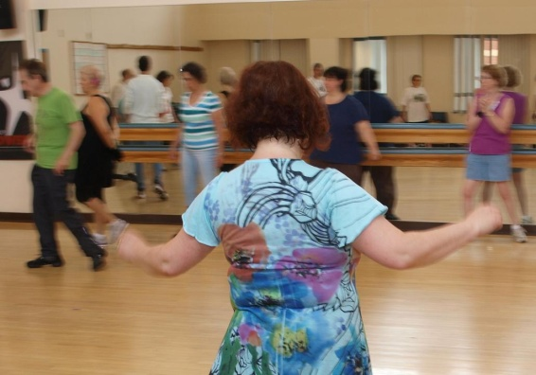
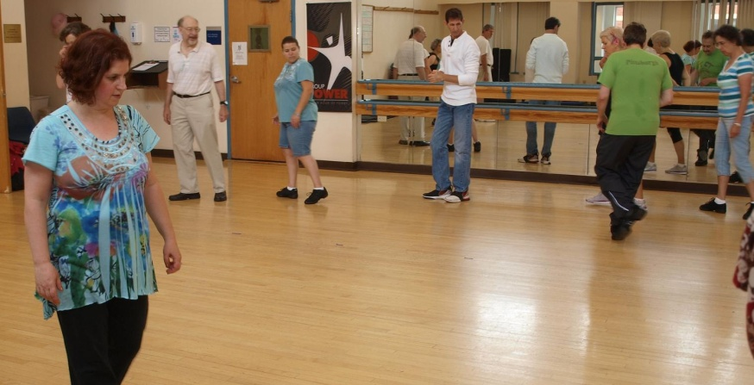
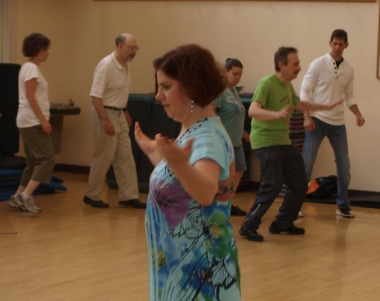
Teaching at the Powwow.
At any Israeli dance marathon, teaching is an essential element. There are currently more than 7000 choreographed Israeli dances and every year adds several hundred to this list. Above, we see Myles, who leads another Pittsburgh session, teaching a dance.
As Myles is teaching, he is joined inside the circle by Lynn who mirrors his steps to the circle.
This is not the only time that Lynn is within the circle. Three dances were taught and Lynn was involved in each
Notes:
pitt12, pitt13, pitt14, pitt15, pitt16, pitt17, pitt18

Slide 9
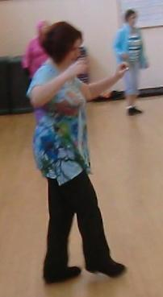
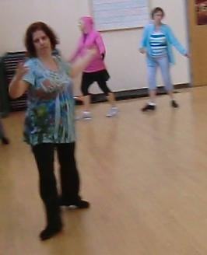
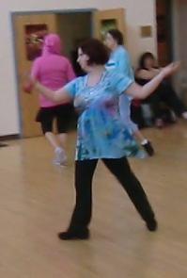
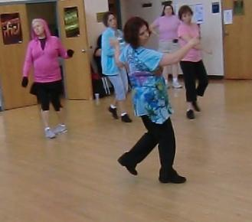
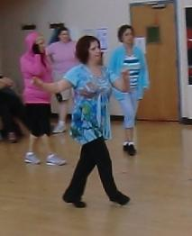
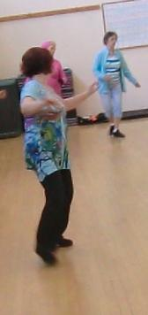
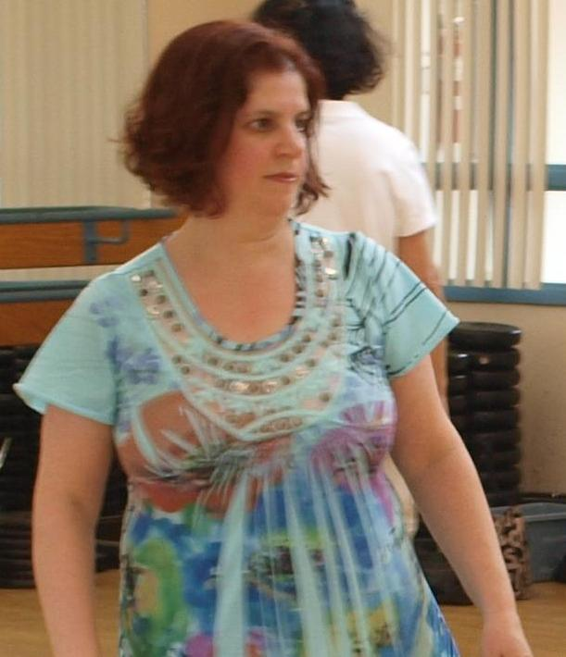
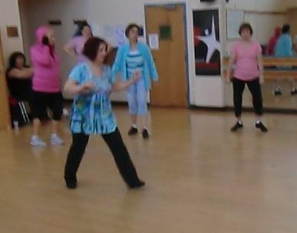
Let’s look at Lynn
Israeli dance is acknowledged to have a steep learning curve. Your instructor has dealt with this genre of dance for 10 years and still considers himself an advanced beginner.
So one is impressed by a relative newcomer who becomes proficient quickly.
Lynn is such an example having about 3 years worth of israeli dance experience. Yet she has become the dance leader for the Pittsburgh session and in these pictures is part of the demonstration of Mei Nahar, a 2012 dance choreographed by Yaron Ben Shimron from music created by Idan Raichel
Notes:
lynn, lynn2, lynn3, lynn4, lynn5, lynn7, lynn8, lynn10

Slide 10
About Mei Nahar
This and the next slide concentrate on the dance, Mei Nahar, which was one of the dances taught. This slide is about its creation both as a song and dance
Idan Raichel (and the Idan Raichel project that he originated and leads), attempts to fuse various themes into music. This song was composed in 2008 for the album, Bein Kirot Beity
Choreographed in 2011 by Yaron Ben Shichon
Dance was demonstrated in the Phila area in March, 2012
Notes:
yaron ben simchon.jpg, idan Raichal.jpg

Slide 11
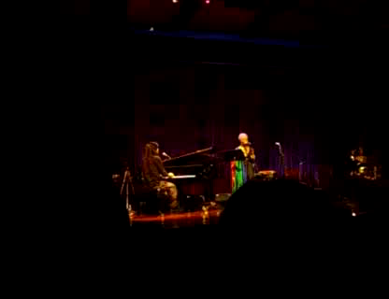

Observing Mei Nahar
Below is a performance of this song at the United Nations by Indie Asia accompanied on the piano by Idan Raichel.
Below, you can see the choreographer, Yaron Ben Simchon with his wife, as they perform this dance.
Click to Play
Click to Stop
Click to Play
Click to Stop
Note: Both of these videos have been copied from youtube

