Slide 1
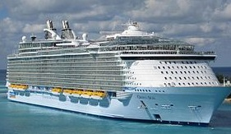
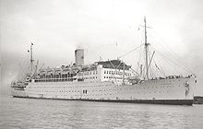

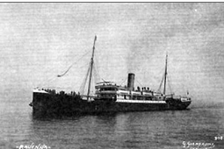
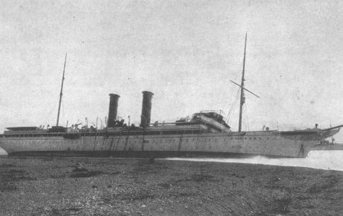


History Of Cruise Ships
Cruise ships and cruises become feasible in the early 1800’s. Prior to this there were only Passenger (some say Ocean) Liners.
Today there are only 2 passenger liners in use: Cunard’s QE and QM2
Below is a list of historic cruise ships (grown to a somewhat respective size)
Strathaird
Revanna
Prinzessin Victoria Luise
France
Liberty Of The Seas
Oasis Of the Seas
It is a cruise in February, 2014, designated as Machol Yam, aboard the Liberty Of The Seas that is the focus of this presentation
Music:
Kmo Sira Trufa translates to Like A Boat Capsizing.
Singer: Aviva Avidan
Choreography: Israel Shiker

Slide 2

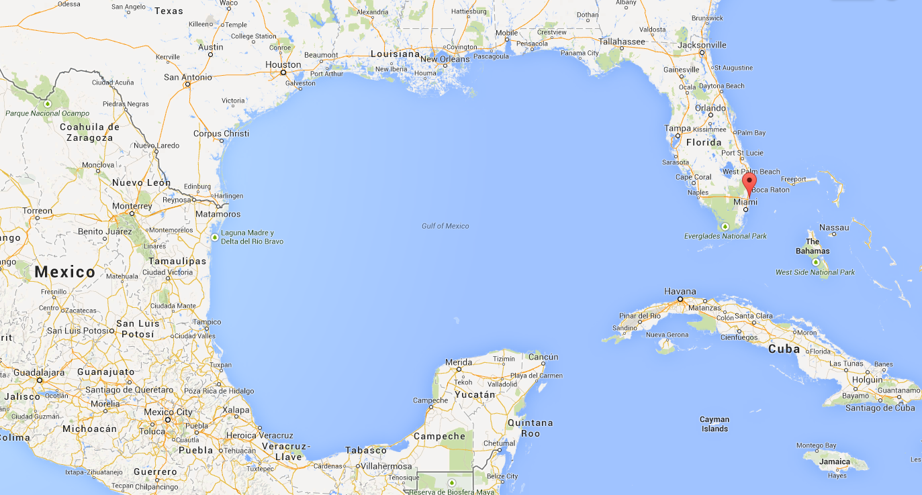
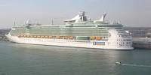
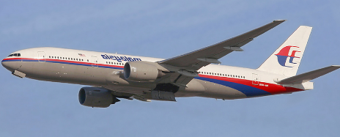
As mentioned, Cruises generally take place outside of oceans, in seas. Oceans are for Passenger Liners, seas are for Cruise ships. One very popular sea is the Caribbean and a very popular cruise route is Miami (Port Everglades) to Cancun as shown below.
Miami to Cancun (and the reverse) can be transversed by car (45 hours), Air (2 hours) or by cruise ship (50 hours). We show this below noting that going by cruise ship is a lot more fun for most travellers

Slide 3
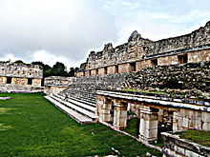
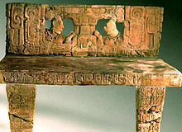
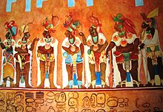
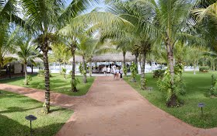
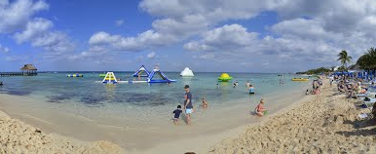
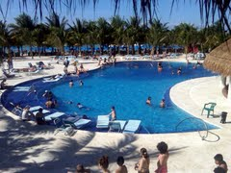



Why Visit Cancun
Mayan Culture
Beaches
Coral Reefs

Slide 4

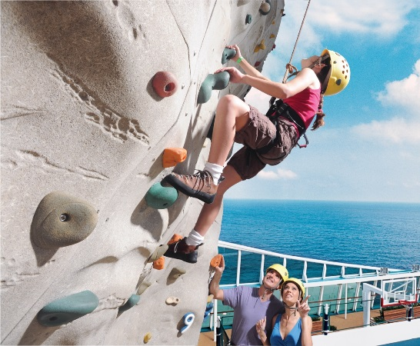
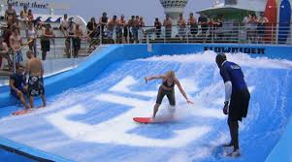

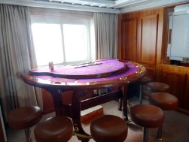
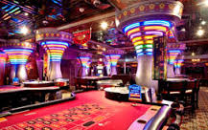
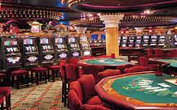
Amenities on a Cruise Ship
Cruise Ships on the high seas today are not designed for educational pursuits. There are smaller ship cruises, generally river cruises, which accentuate the educational and the cultural aspects of travelling
The big behemoths are created to be combinations of DisneyWorld and Las Vegas. What’s on these ships
Swimming and water sports
Rock Climbing
Ice Skating
Sunbathing
Gyms/Spas
Golfing
But, a major allure is Gambling

Slide 5
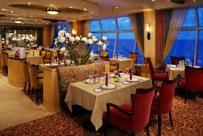
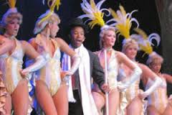
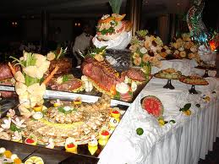
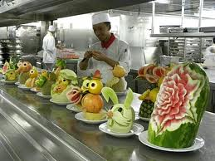
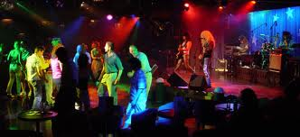

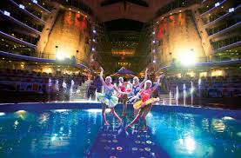
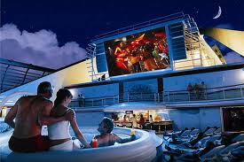
Of Course, Cruise Ships are also known for cuisine and entertainment
We show some pictures from the Internet highlighting this

Slide 6
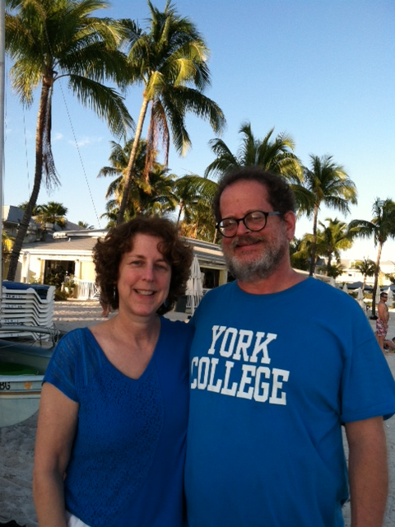

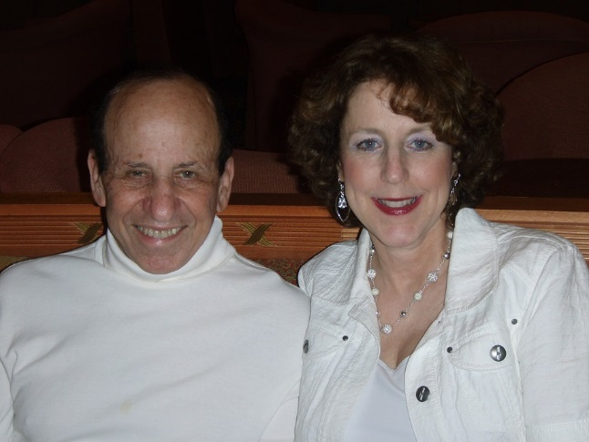
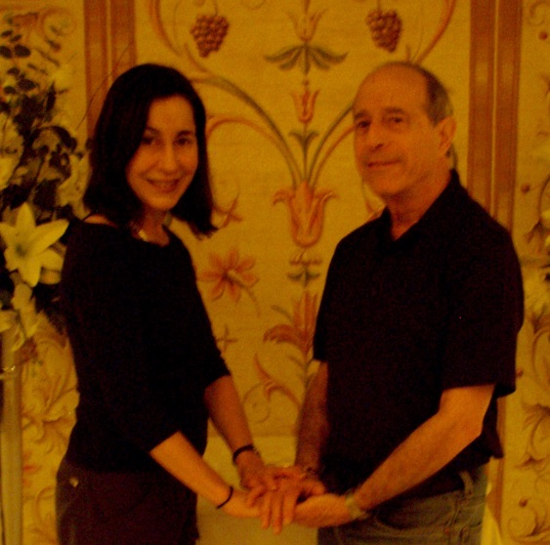
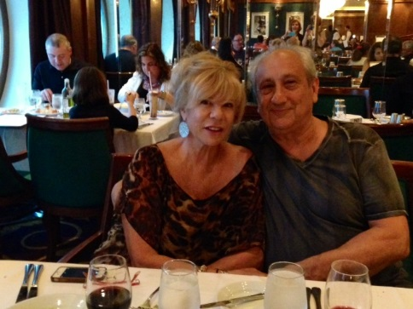

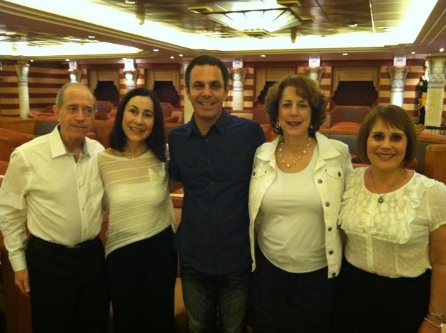

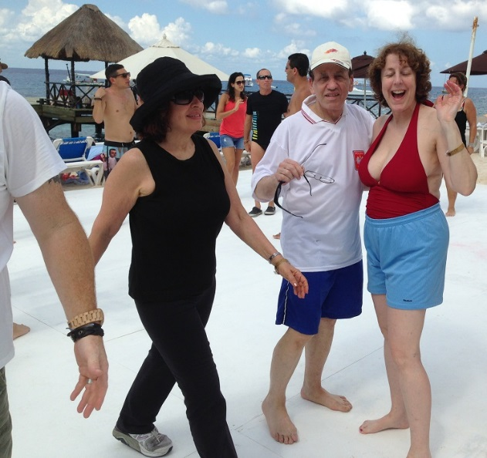
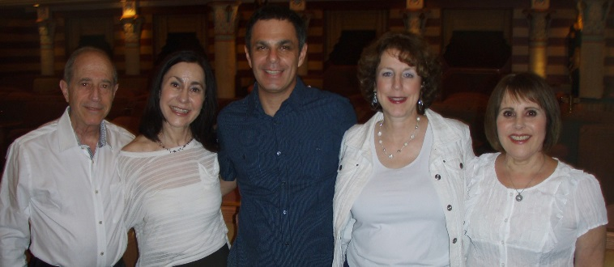
The Cruise In Question: Machol Yam, a Dance Cruise
The Philadelphians on the Cruise
The Philadelphians at Play

Slide 7
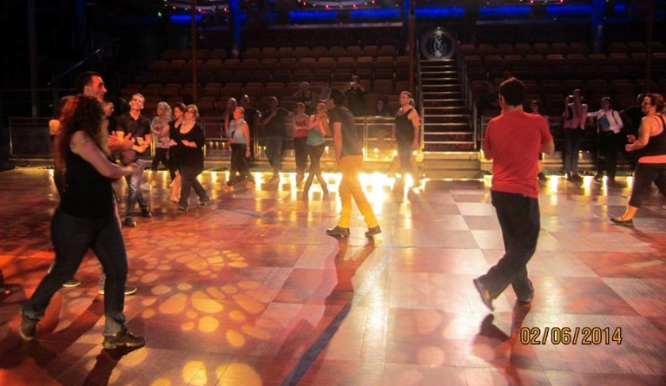
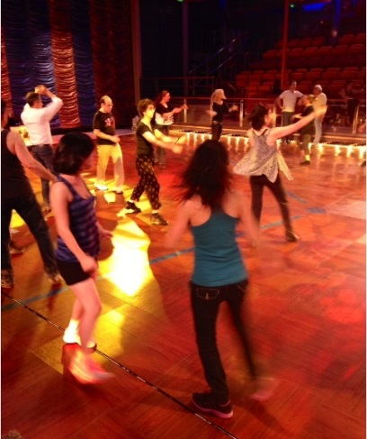
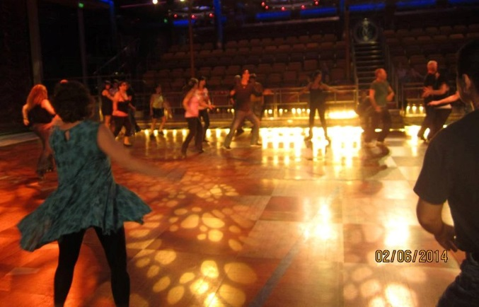
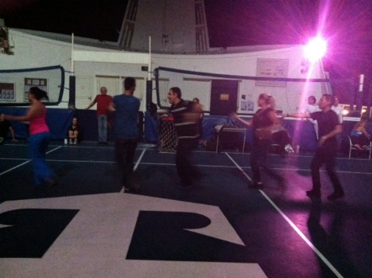
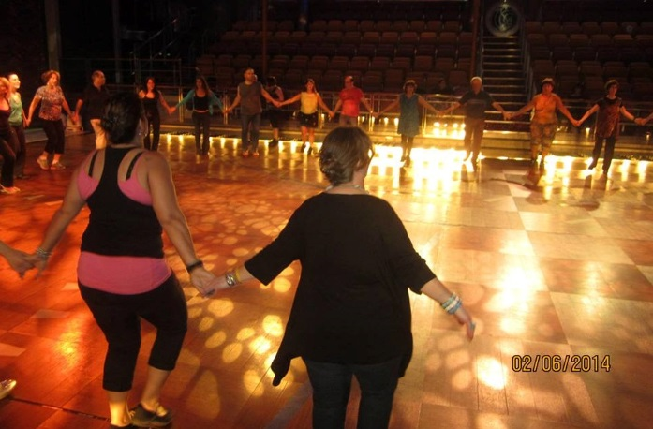
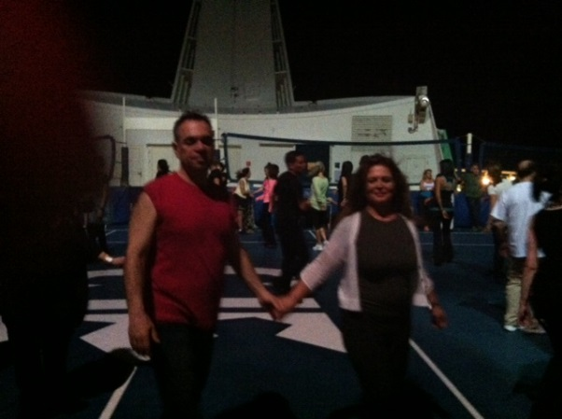
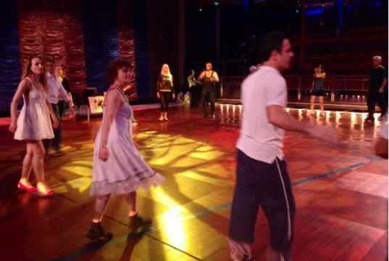
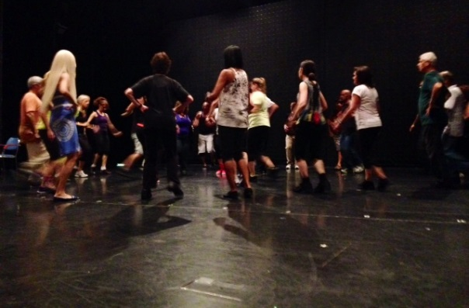
Dancing on the Sea
Dancers Like to dance as these pictures show
While not as stable as dance floors on land, the dancers make do as you see here. And these sessions go through the night. Dancers on this cruise, besides from Philly, came from New York and Florida
When the weather allows, dancing occurs on the Basketball court. When indoors, the dancers replace the performers on the ship stage

Slide 8

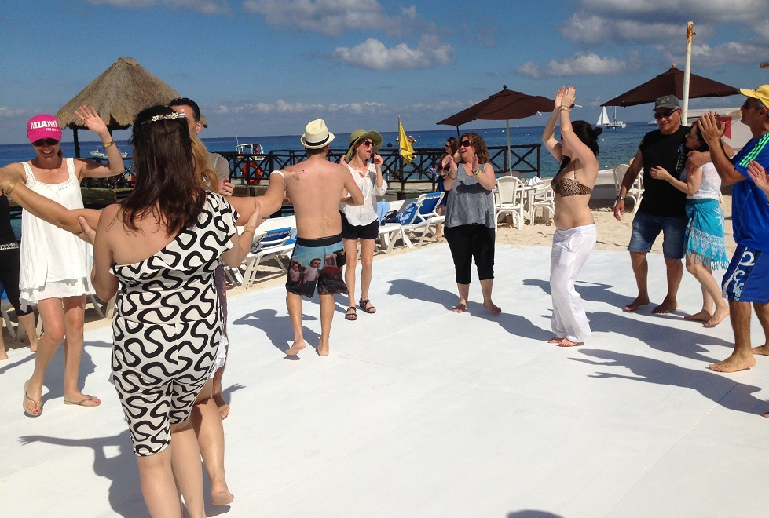
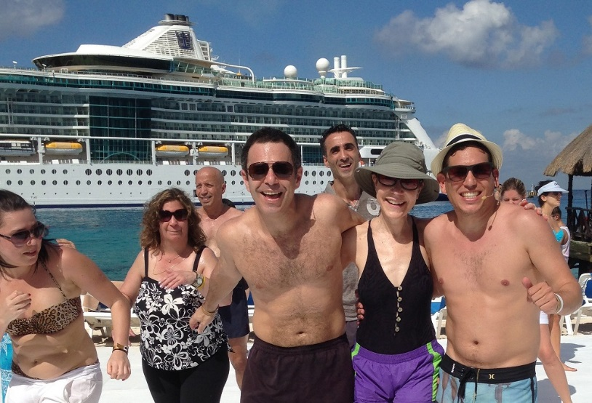



Besides dancing on the seas, the members of the cruise dance when on land as these pictures show

Slide 9

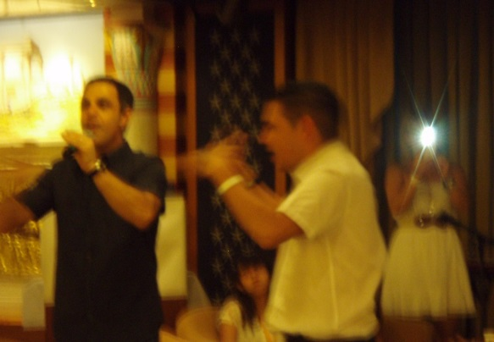
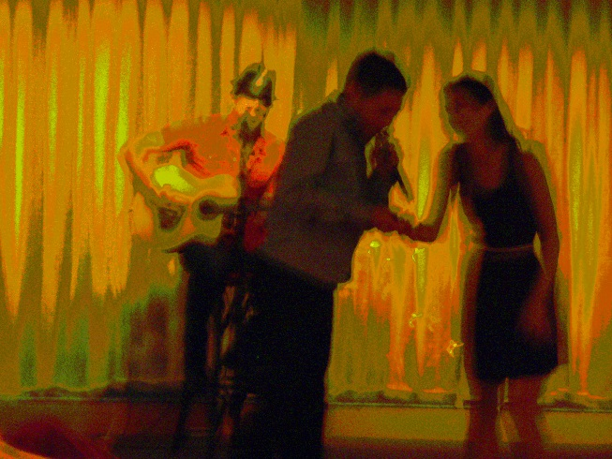
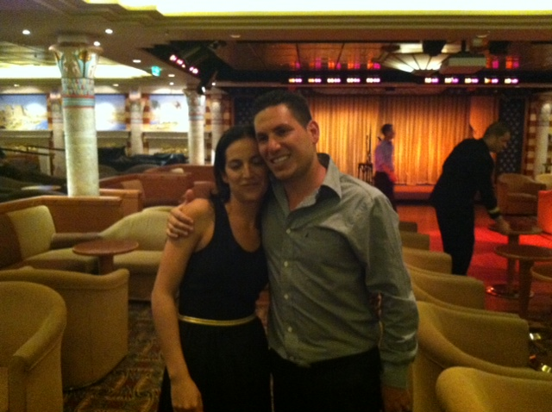


So, What do we know about this cruise
At sea From Feb 6 through Feb 10
Aboard Royal Caribbean’s Liberty Of The Seas
Transiting from Miami to Cancun and back
Nights spent dancing either on the ship stage or on the basketball deck
Featured choreographers were Eyal Bitton and Oren Ashkenazi. In Oren’s case many of the dances demonstrated were of his choreography
Featured Singer was Sagiv Cohen
Eyal has an additional surprise for the dance cruise
Eyal surprises everyone, but especially his girlfriend, with a surprise proposal tendered and accepted (the pictures here represent the sequence of events with the middle being a poorly lit shot of the proposal)

